Slide 1

Lesson 10: Search Engine Verticals
Kubilay Cagatay
WEB 225

Slide 2

What are search engine verticals?
Similar to specialized search engine results
Can include media along with normal text
Search Engine Page Results (SERP) can be dependent on location of the user

Slide 3

Some examples
Universal search
Image search
Video search
Local search
Instant search

Slide 4
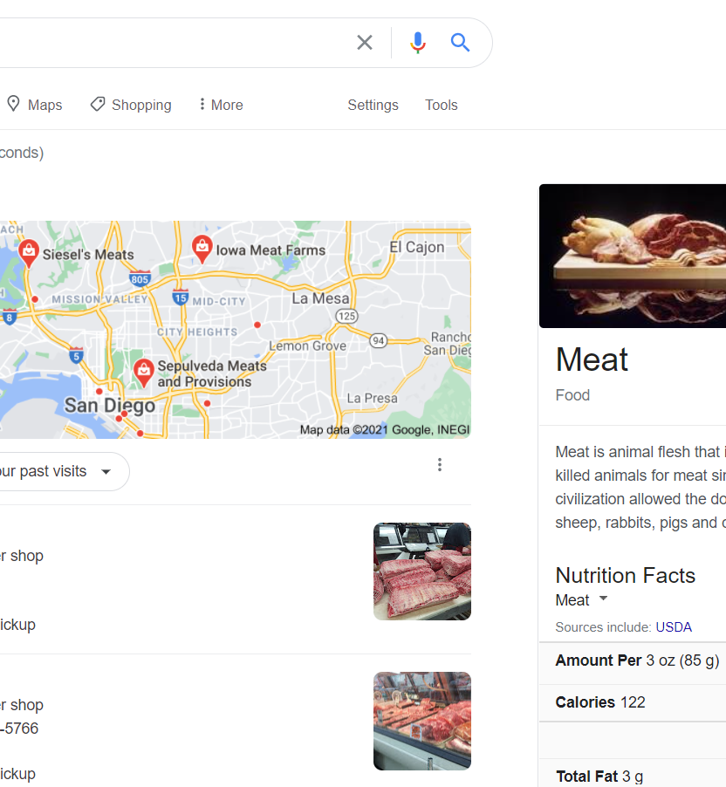
Universal Search
Search results that include all types of media show up for the person looking something up (images, videos, news, maps, typical web links)
Due to the possibility that someone who searches “meat” may be interested in buying meat from a butcher shop nearby, be looking for a recipe for dinner that night, or be looking for pictures of meat, search results that include all the possibilities on the first page are liked by searchers
More types of content available but few spots available in the top spots makes it competitive

Slide 5

Local Search
Types of searches that get filtered and narrowed down based on where the user is
Locations can be determined by many ways:
Search engine top level domain for country (with country added at end of URL)
IP address for a specific location
Through user provided information – the user is asked where they are searching from then it is saved through cookies

Slide 6

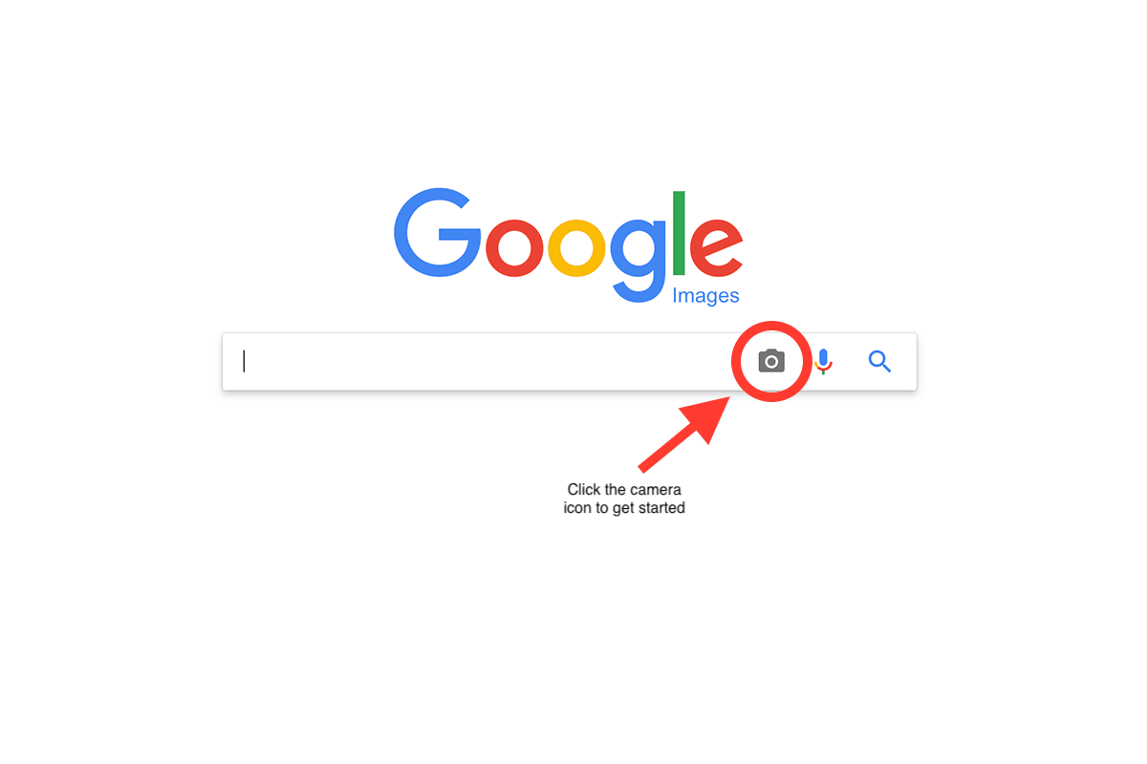
Image Search
A user can look up topics and get image results
Now, there is reverse image search where you can upload a picture and get results based on that image

Slide 7
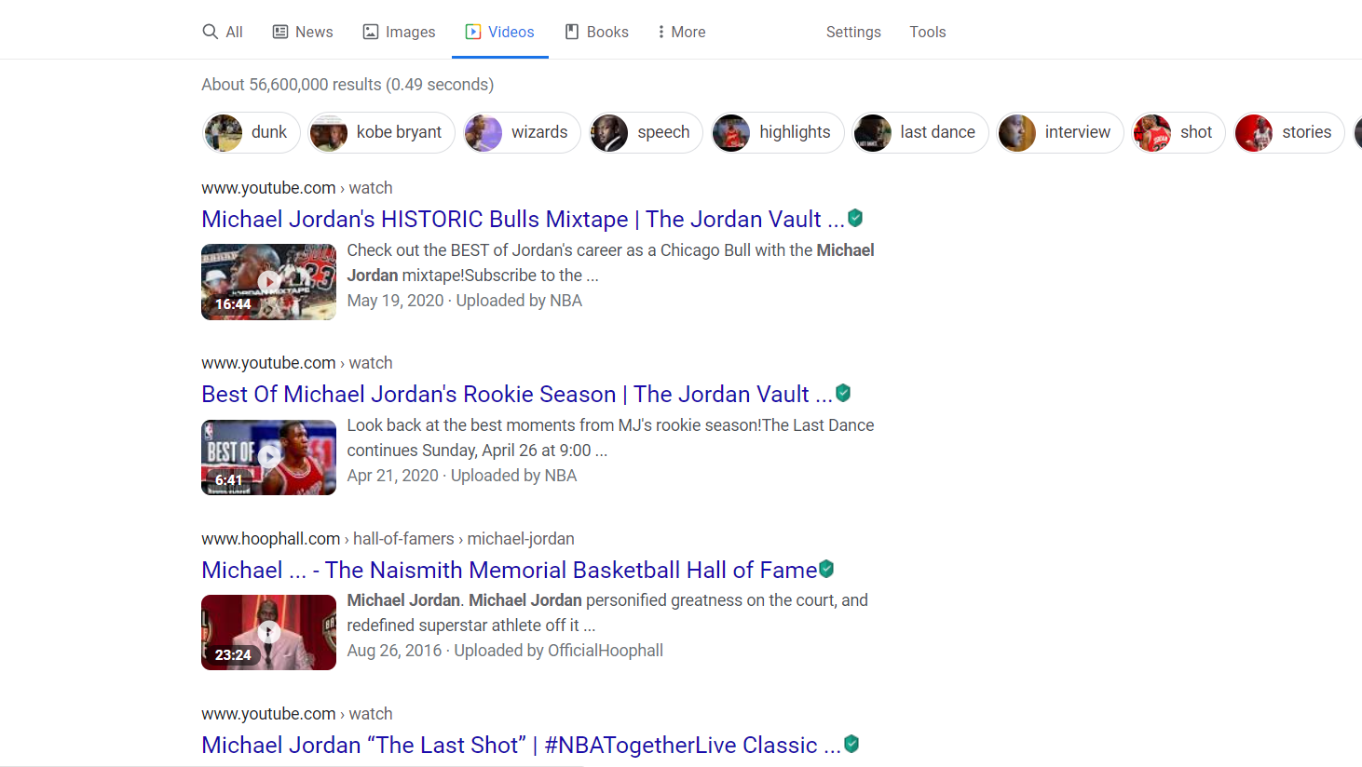
Video Search
Can search and find videos related to a topic
Now, searches pull videos embedded in websites and videos from YouTube
Videos get ranked based on title, description and engagement

Slide 8
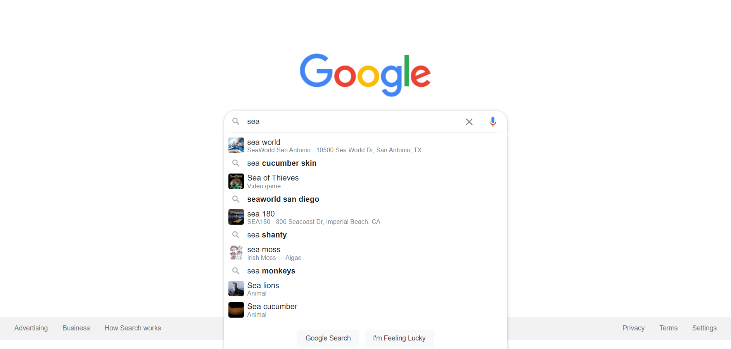
Instant Search
Google’s predictive search
A user types the beginning of a word/phrase and Google will “predict” the most likely end result for that user
Difficult for SEO consultants to fully optimize client's site for

Slide 9

These alternatives vs. traditional search
Today’s Google search results have come a long way since the book was written
Many of these concepts were very useful and liked by searchers that they are now commonplace
When searching now, all outputs are given to the searcher on the first page of Google (images, videos, news, maps, websites)

Slide 10


Thank you!

